Slide 1
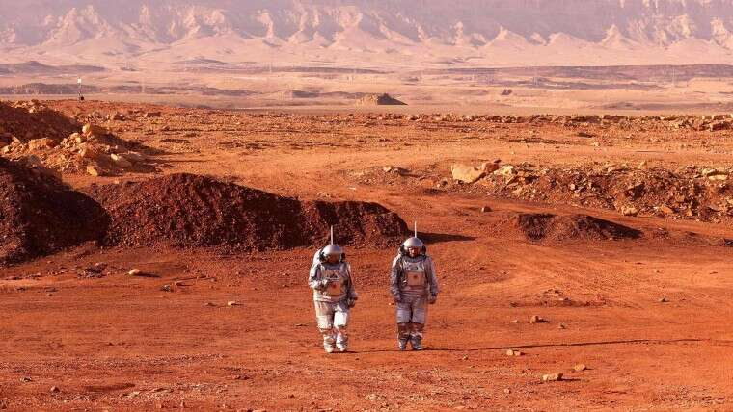
Why we think to move on different planet

Slide 2
NASA FUTURE MOON MISSION
We all know that Nasa prepared for next maned moon mission which will conducted on next upcoming years.
Artemis 1 (2022)
Artemis 2 (2024)
Artemis 3 (2025)
Artemis 4 (2027)
 | US$93 billion (2020–2024)

Slide 3
WHY??
Why we think to move on different planets like Mars, Moon.

Slide 4
Reasons to move on different planet
Main reasons to move on different planet is that
1)Global Warming(heating earth surface, change climate)
2)Increasing Population
3)Collision of Asteroids

Slide 5
Earth
Earth is our home. Our place of birth, our place of growth and the place which we have evolved to live on. Why we lose our beautiful planet.

Slide 6
Expensive
If we use this 93 billion us dollars to take strict actions against pollution and populations. then we not need to move on another planet.
Musk plans to build a self-sustaining city on Mars.
Even we all know that there is no oxygen is present on another planet.
Then how we create humans colany. It will be very expensive.

Slide 7
Solutions
1) Take strict actions against increasing population
2) Take actions against factories which released more toxic gases, use CNG vehicles, E-Vehicles.
3) Using electronics missile we can easily target any upcoming asteroid. And change direction of asteroids.
In this way we can save our earth and save lots of economy to finding another planet.

